Slide 1
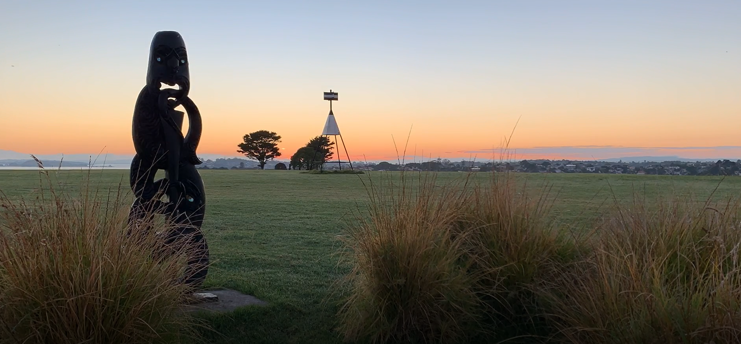
Nau mai, haere mai ki Ōrākei...
Notes:
I’ve kept this template as simple as possible so you can easily edit and customize. You should make edits and changes based on your specific situation. I’ve kept it as generic as possible so it will work in many situations with minimal adjustment.

Slide 2
Whakapapa (History)
Migrated on Māhuhu ki te rangi
Until 1700’s lived in Kaipara
Conquered Tamaki early 1700’s
Consoldiated 3 Tribes moved to Ōrākei
1840 Apihai Te Kawau / Gov. Hobson
Land systematically taken up until 1951
1977-78 Bastion Point Occupation
Notes:
I’ve kept this template as simple as possible so you can easily edit and customize. You should make edits and changes based on your specific situation. I’ve kept it as generic as possible so it will work in many situations with minimal adjustment.

Slide 3
Our Hapū (Our Tribe)
Māori indigenous people of Aotearoa
Land owners & guardians in Auckland
Orākei Marae is our ancestral home
5182 tribal members
Leaders and visionaries
$1.2 Billion asset base
Notes:
I’ve kept this template as simple as possible so you can easily edit and customize. You should make edits and changes based on your specific situation. I’ve kept it as generic as possible so it will work in many situations with minimal adjustment.

Slide 4
Nga Matapono (Our Values)
Rangatiratanga (Leadership)
Kaitiakitanga (Guardianship)
Manaakitanga (Generosity)
Whanaungatanga (Connection)
Kotahitanga (Unity)
Mana Taurite (Equity)
Ahi Kaa (Home Fires Burning)
Notes:
I’ve kept this template as simple as possible so you can easily edit and customize. You should make edits and changes based on your specific situation. I’ve kept it as generic as possible so it will work in many situations with minimal adjustment.

Slide 5
NWOT (PSGE)
Orākei Marae
Whai Maia
Whai Rawa
NWO Structure
Notes:
I’ve kept this template as simple as possible so you can easily edit and customize. You should make edits and changes based on your specific situation. I’ve kept it as generic as possible so it will work in many situations with minimal adjustment.

Slide 6
Whai Maia – Tribal Development
Culture & Language
Environment
Education
Health
Wealth & Prosperity
Housing (rental)
Ventures & Opportunities
Notes:
I’ve kept this template as simple as possible so you can easily edit and customize. You should make edits and changes based on your specific situation. I’ve kept it as generic as possible so it will work in many situations with minimal adjustment.

Slide 7
Whai Rawa – Commercial
Commercial Property Ownership
Property Developers
Eastcliff, Retirement Village
Tourism
Toi Tupu, Whanau Savings
Whanau Housing Developments
Notes:
I’ve kept this template as simple as possible so you can easily edit and customize. You should make edits and changes based on your specific situation. I’ve kept it as generic as possible so it will work in many situations with minimal adjustment.

