Slide 1
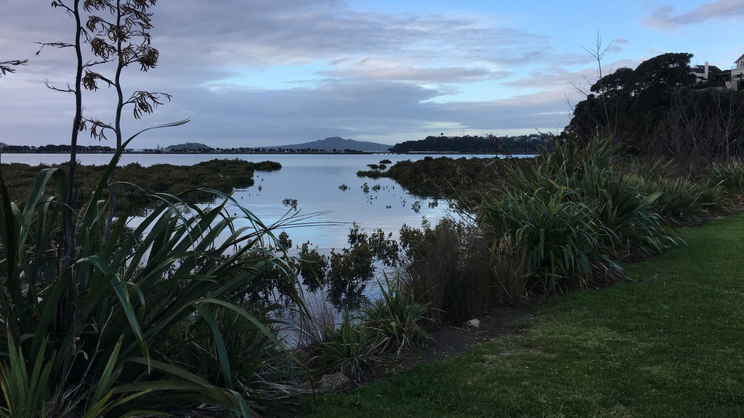
Waitaramoa (Hobson) Bay
Elsa Taylor

Slide 2

Summer of 1949/50

Slide 3
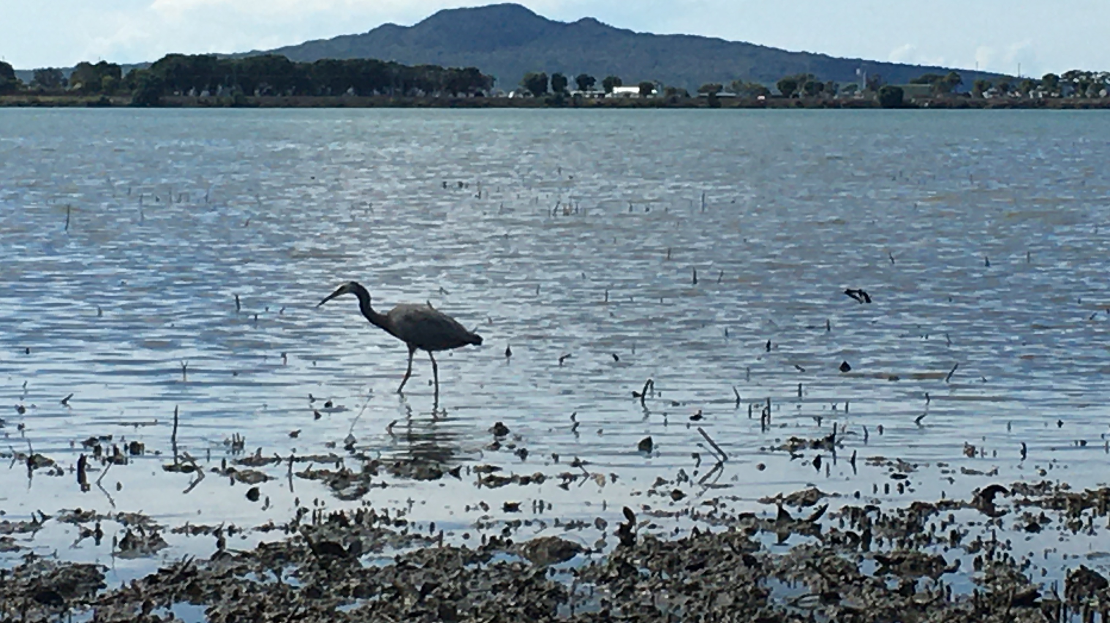
Waitaramoa Bay

Slide 4
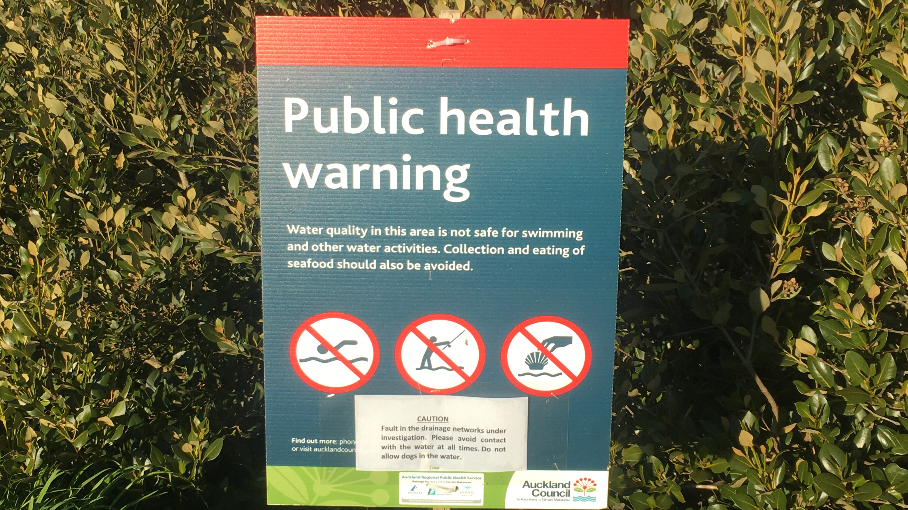

Slide 5

What do all the words and numbers mean?
?

Slide 6
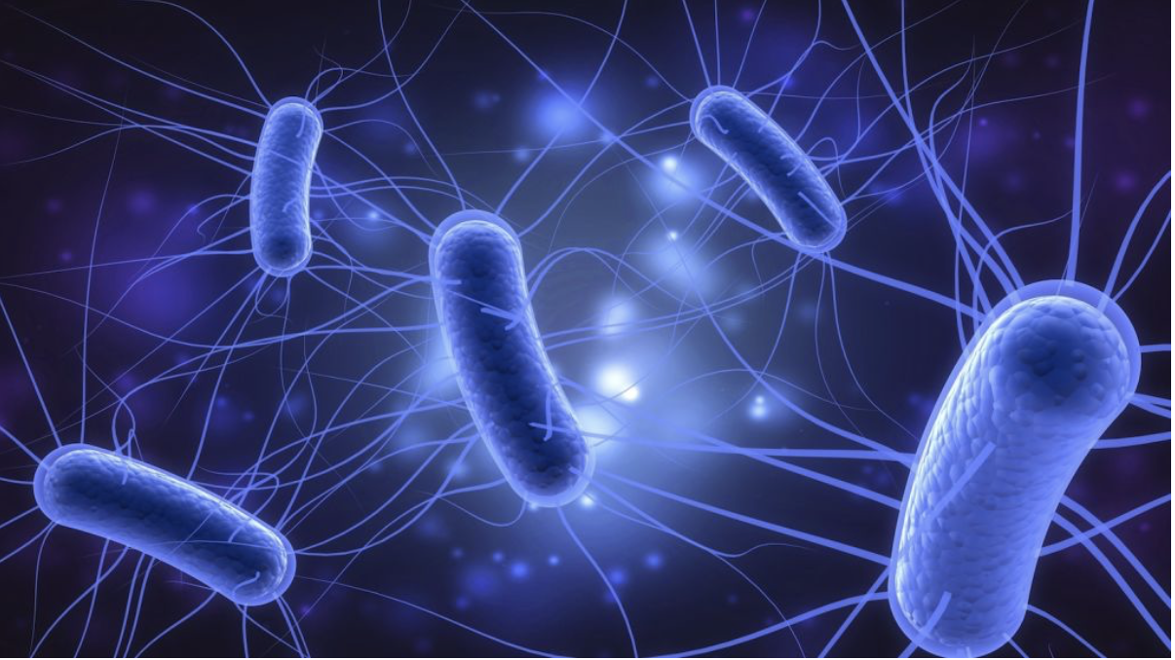
E.Coli and Enterococci
                Marker
                Indicates faeces/poo

Slide 7
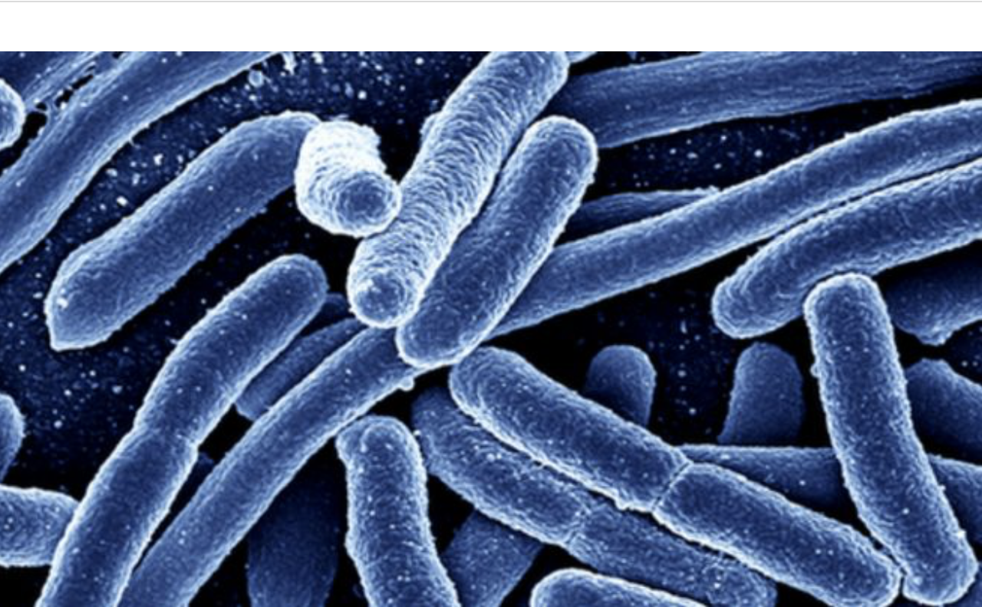
Risk quantification
130 e.coli/100ml risk of infection with single exposure 1 in 1000
260 e.coli/100ml risk of infection with single exposure 1 in 100
540 e.coli/100ml risk of infection with single exposure is 5 in 100

Slide 8
Median
95% centile
% of time >260
% of time >540

Slide 9
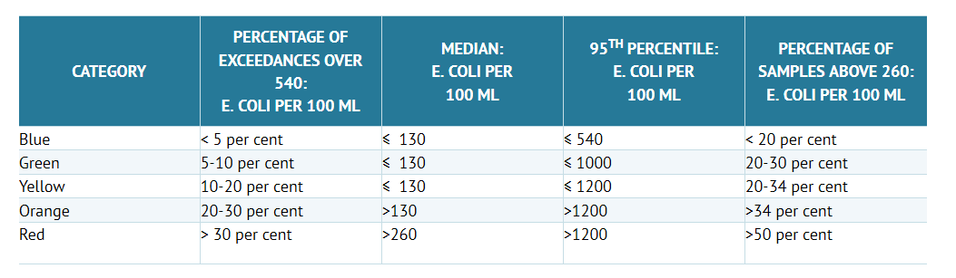




Waitaramoa Bay streams
RED
  Exceeds >540/100ml 89%of the time!
  Median 7900 e.coli/100ml
  95th percentile 200 000 e.coli/100ml
  Percentages of samples>260 94% of the time

Slide 10


Once 95th centile e.coli >540 NOT safe to swim
Our 95th centile is
200 000 (streams)

Slide 11
What about sea water?
Enterococci 95 centile >500 NOT safe
Our 95th centile is
16 150
(at collection points 201 and 204)

Slide 12

Once median e.coli >1000 NOT safe for water activities such as kayaking, paddle boarding etc
Our median is 7900 e.coli/100ml
This is across all sites
Many sites much higher

Slide 13
Bottom line
Testing in the Waitaramoa Bay area demonstrates extremely contaminated water
Health risk is VERY HIGH

Slide 14
What are the health risks
Gastroenteritis
Ear, Nose, Sinus and Chest infections
Skin infections
Waterborne epidemics

Slide 15
Really?
Delay between water event and illness
Not all infections are clinical or significantly symptomatic
Surveillance difficult as a minority visit a doctor and even those that do majority are not recognized as waterborne and not reported to public health

Slide 16
Other points
Wastewater and sewage contains other environmental contaminants
Human health risks poorly characterised
Heavy metals and hydrocarbons runoff from urban areas
Sediment and shallows may have greater concentrations of contaminants – children are at risk playing here
RISKS with Fishing and shellfish gathering in contaminated water

Slide 18
Next few slides not part of the presentation but contain tables that have fresh water and marine grading on

Slide 19
Ministry for the environment E.coli Swimming categories
Table 6: MfE Website E. coli Swimming Categories

Slide 20
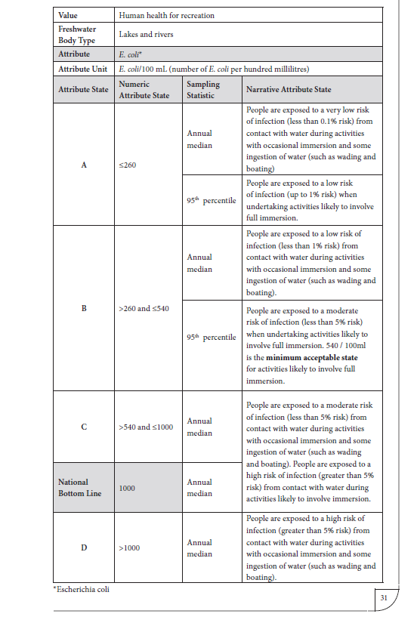
coli.

Slide 21
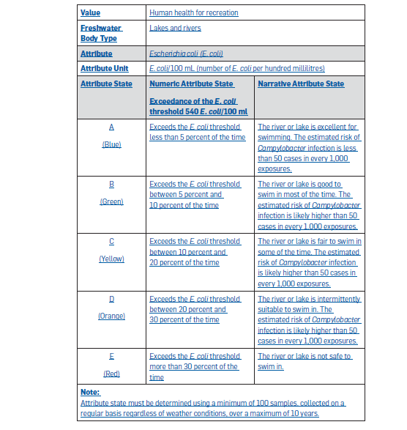
coli.

Slide 22
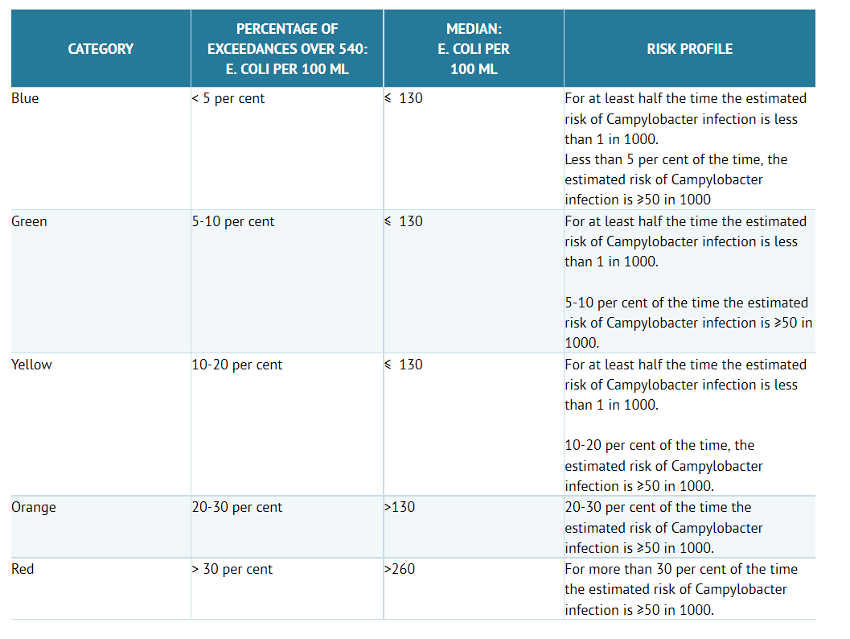
Table 7: Clean Water Risk ProfileThis is Table 2 on MfE’s ‘The risk profile of categories (attribute states).

Slide 23
Marine water grading
Susceptibility to faecal influence | Microbiological Assessment Category Indicator counts (as percentiles - see Table D1) |  |  |  | Exceptional circumstances ***
 | A =< 40 enterococci/ 100 mL | B 41-200 enterococci/ 100 mL | C 20-500 enterococci/ 100 mL | D >500 enterococci/ 100 mL
Sanitary Inspection Category: Very Low | Very Good | Very Good | Follow Up** | Follow Up**
Sanitary Inspection Category: Low | Very Good | Good | Fair | Follow Up**
Sanitary Inspection Category: Moderate | Follow Up* | Good | Fair | Poor
Sanitary Inspection Category: High | Follow Up* | Follow Up* | Poor | Very Poor
Sanitary Inspection Category: Very High | Follow Up* | Follow Up* | Follow Up* | Very Poor
Exceptional circumstances

Slide 24
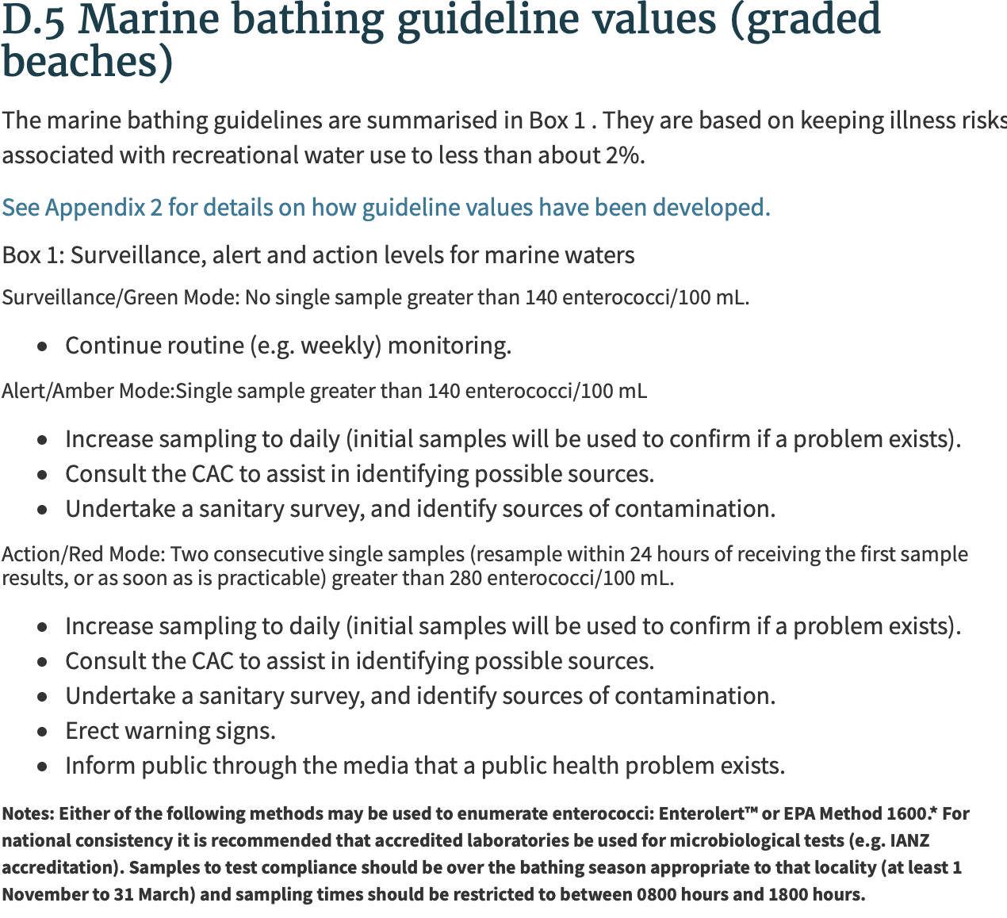

Slide 25
