Slide 1
Hapua Thrive
Vision: ‘a healthy valley and foreshore appreciated and nurtured by the community'
’
www.tusharma.com

Slide 2

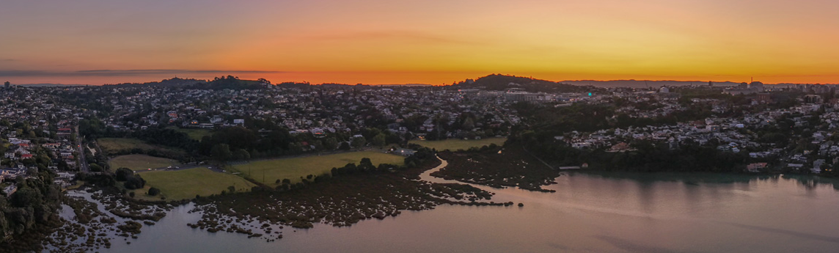
Progress on water quality in the Bay since the 2019/2020 fright

Slide 3
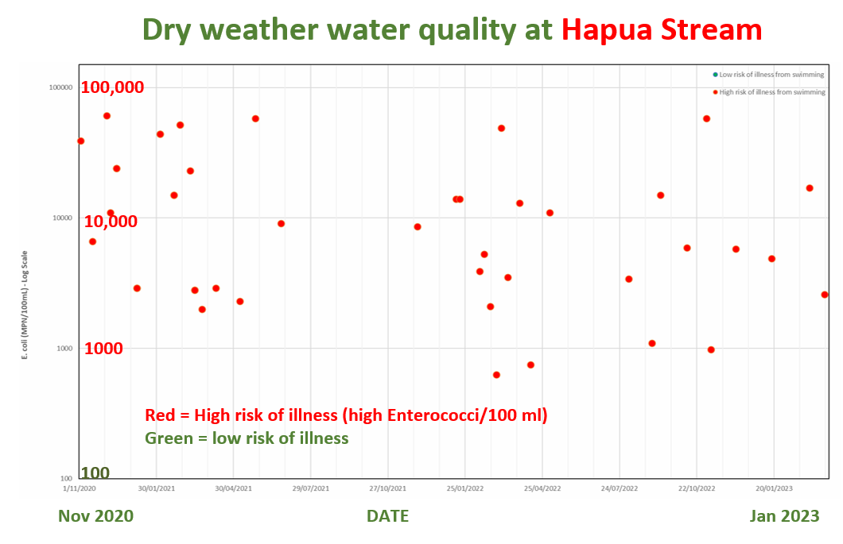
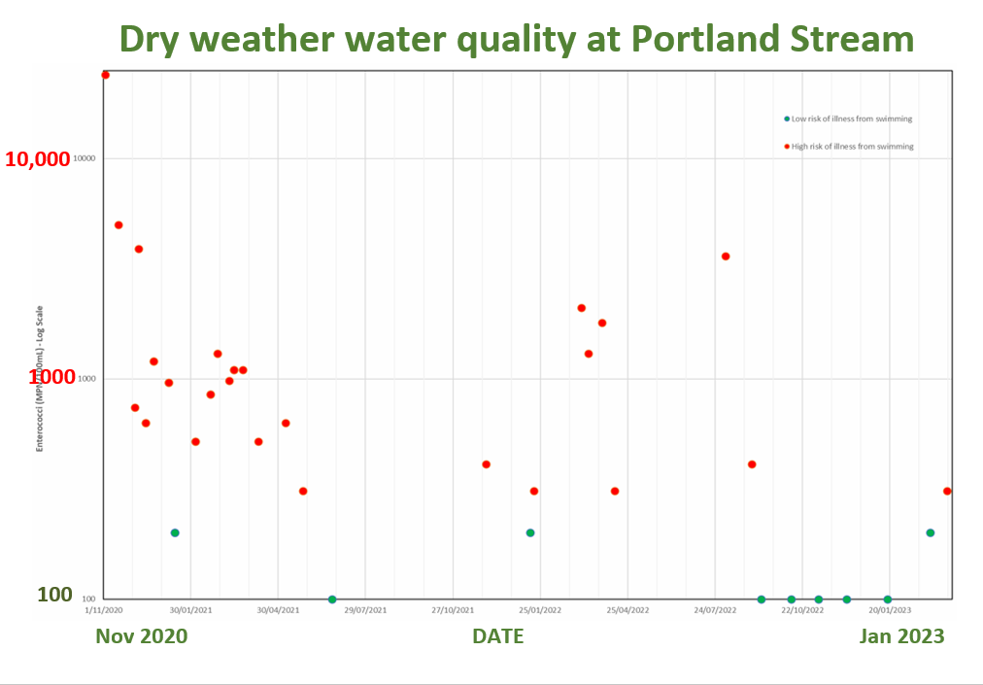
2019/20 ‘STINK’ water quality
Stinky streams and dirty-looking water
Community concerned about safety of
swimming/kayaking/paddle-boarding in the bay
playing in streams and bay – retrieving balls
walking the school bus on wet days
school activities in parks?
fishing for flounder and other kaimoana
Council tested water at all inlets into the Bay through summer 20/21 to diagnose size and scale of the issue
Hapua Reserve

Slide 4
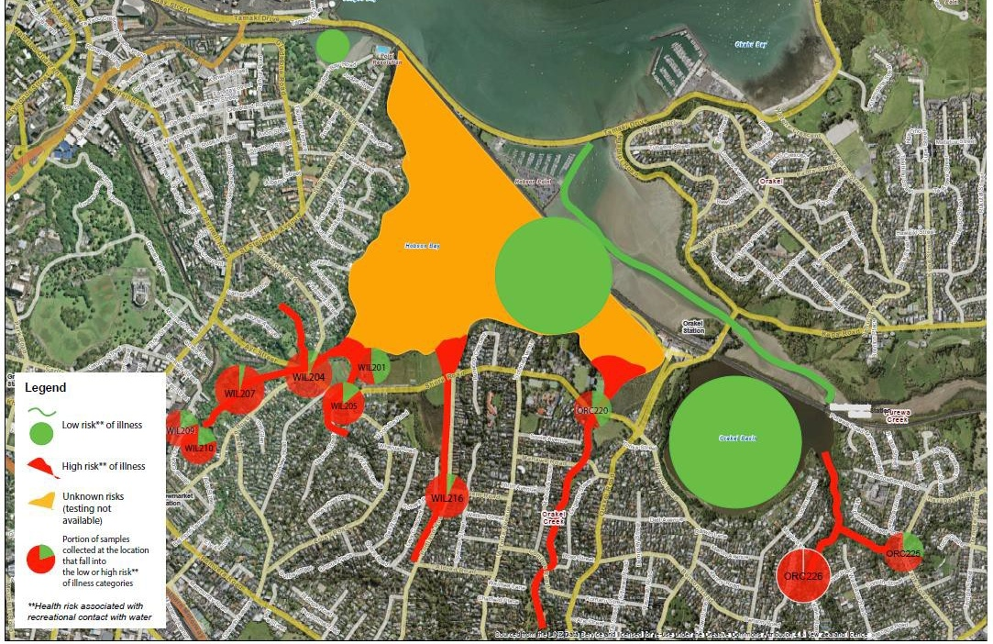
Notes:
Findings in 2020 – DRY Waether – less than 0.5 mm of rain

Slide 5
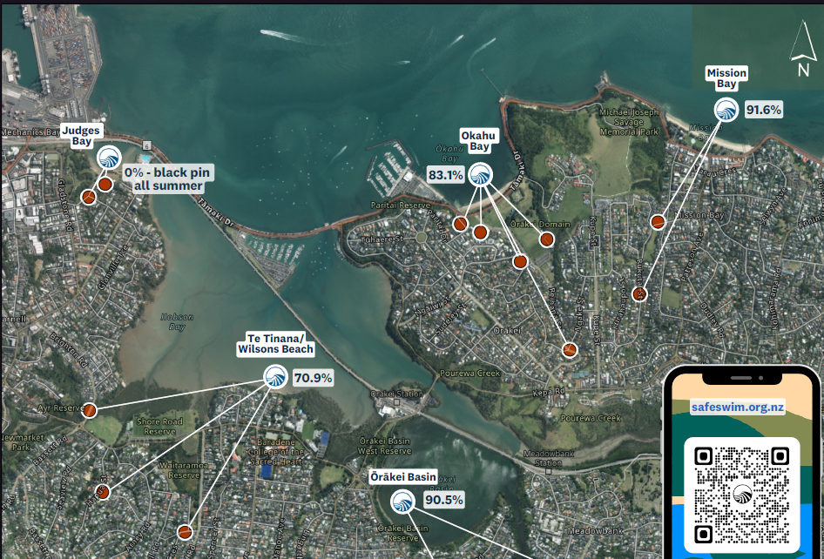
Two new Safeswim sites; confidence when to swim
Hapua Reserve

Slide 6
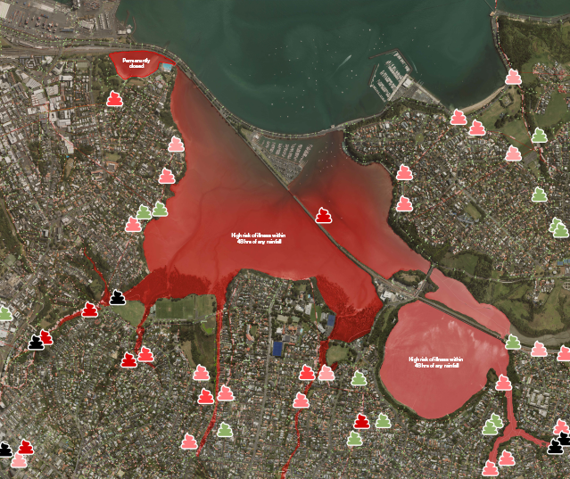
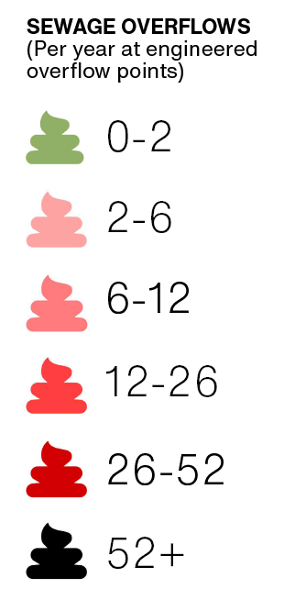
But wet weather overflows are probably unchanged within the Bay…
Hapua Reserve

Slide 7
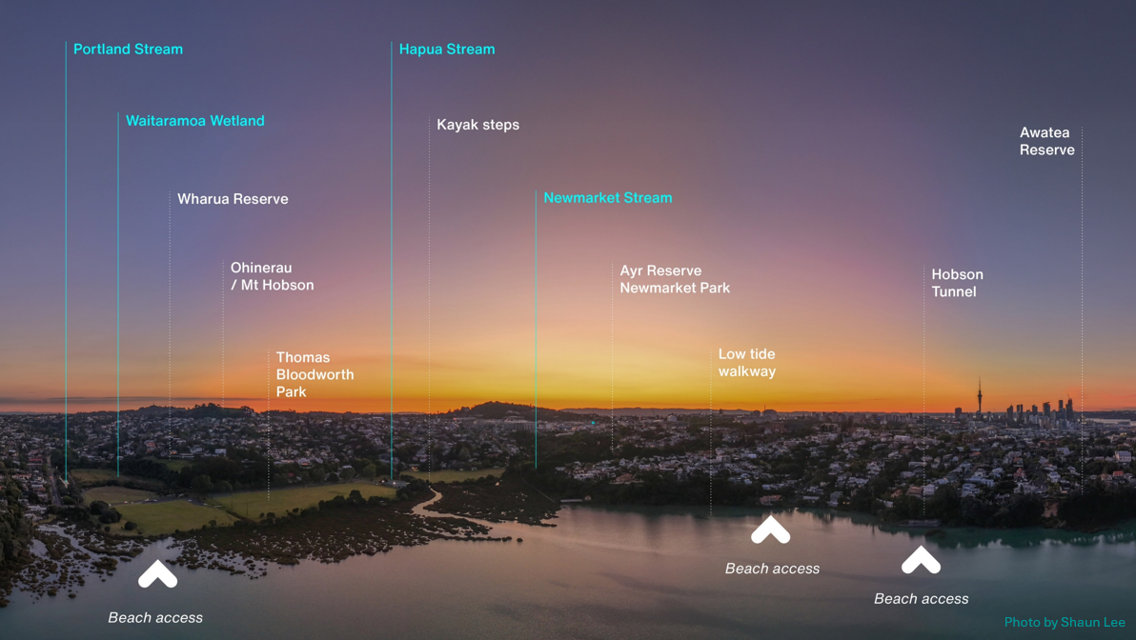


Slide 8
Three actions now to deliver a thriving bay

Slide 9
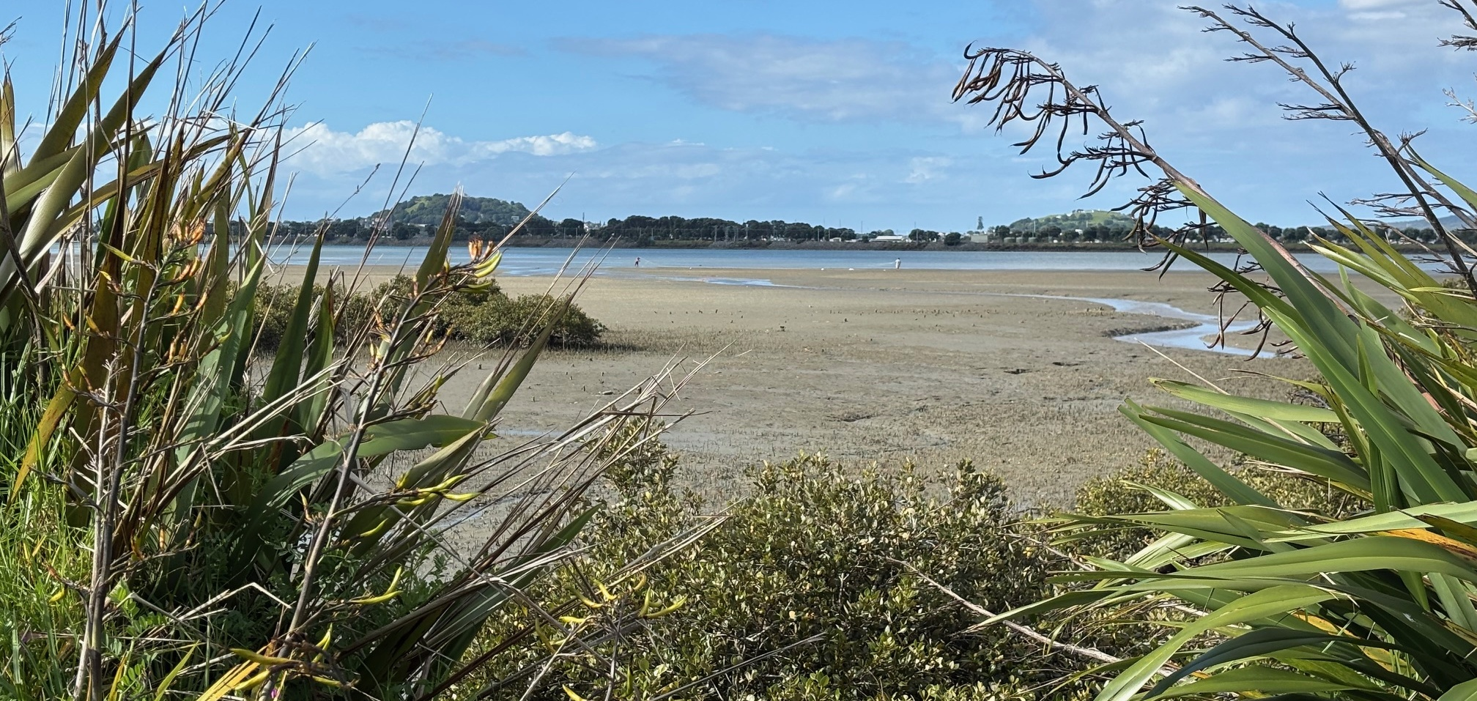
1. Use our new Safeswim sites to have confidence to swim
Hapua Reserve

Slide 10
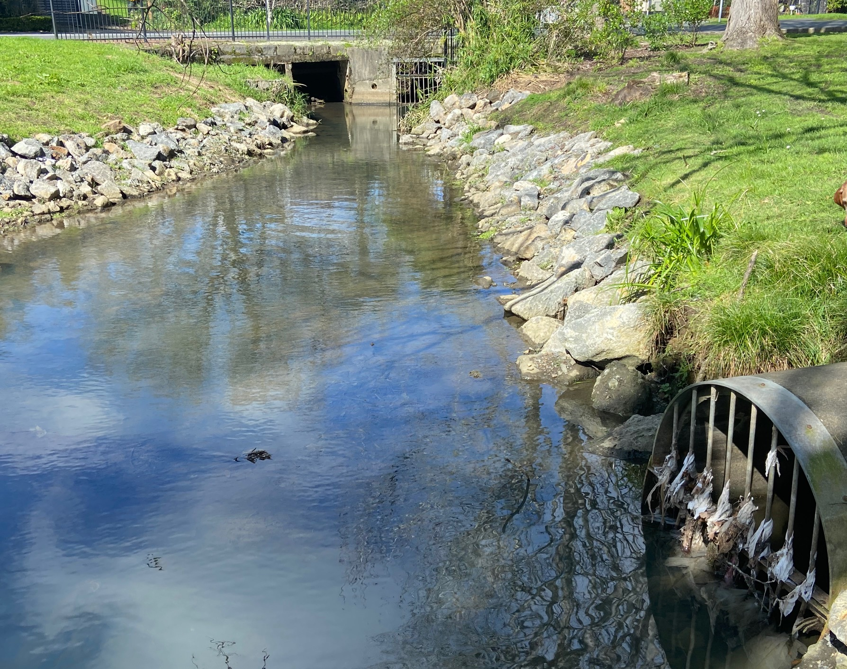
Don’t flush wet wipes!
Portland Reserve

Slide 11
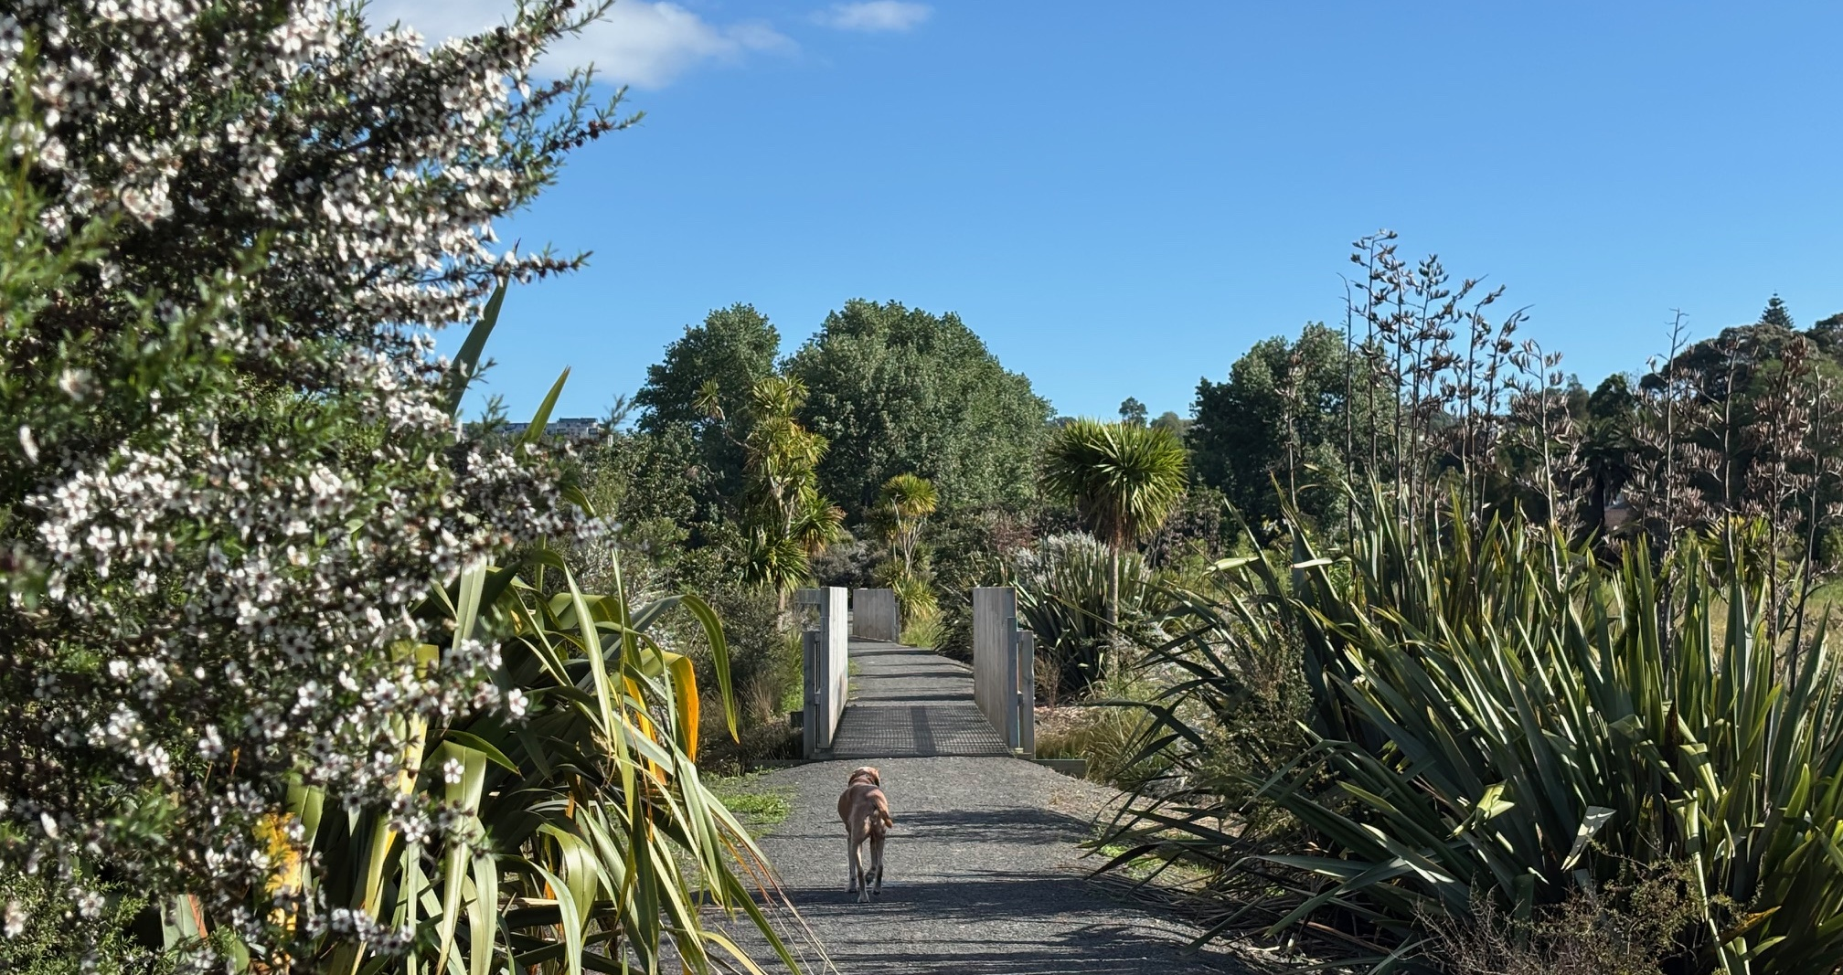
2. Support Hapua Stream renovation
Hapua Reserve

Slide 12
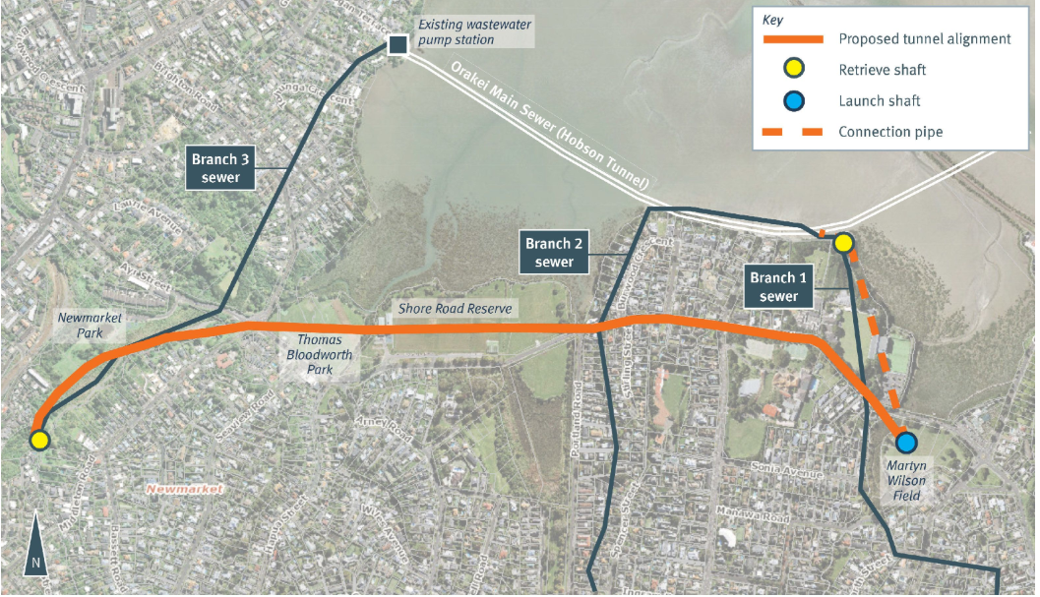
3. Support Newmarket Gully project to reduce overflows (Newmarket Gully wastewater project)
Hapua Reserve

Slide 13


What would help you connect more often and more closely with the bay?
Send us your feedback hapuathrive@gmail.com
Photo by Shaun Lee

Slide 14
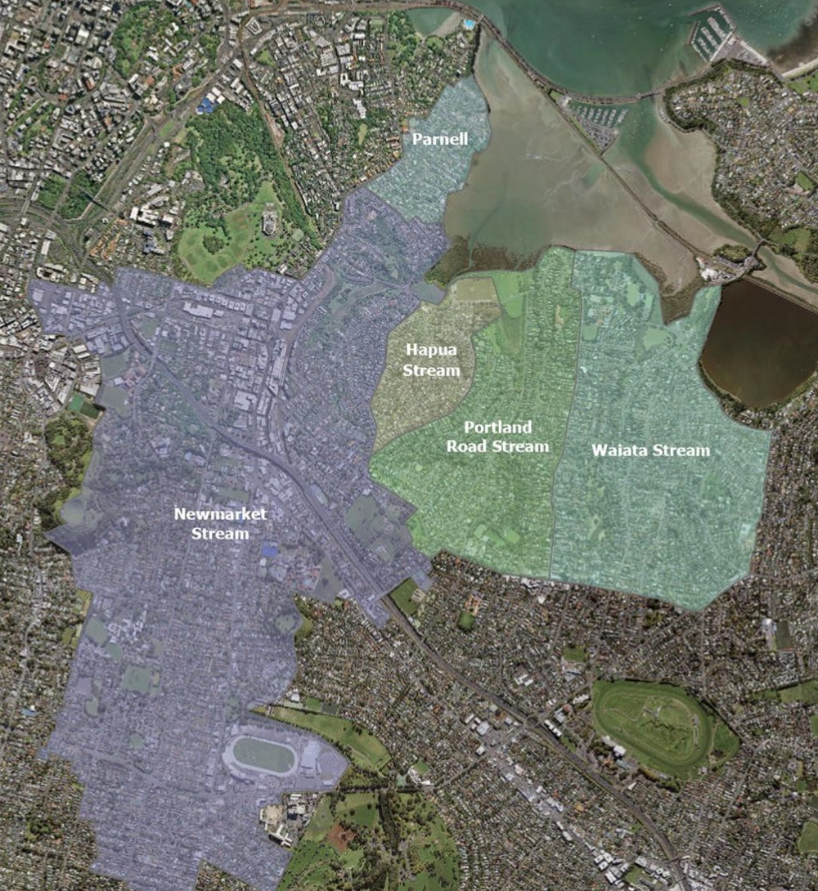

Faults Found to March 2023
Sub- catchment | Private issues | Private issues resolved | Public issues | Public issues resolved
Parnell | 3 | 33% | 9 | 100%
Hapua | 19 | 90% | 22 | 64%
Portland | 6 | 33% | 9 | 78%
Newmarket | 10 | 70% | 21 | 57%
Total | 37 | 56% | 61 | 75%

