Slide 1
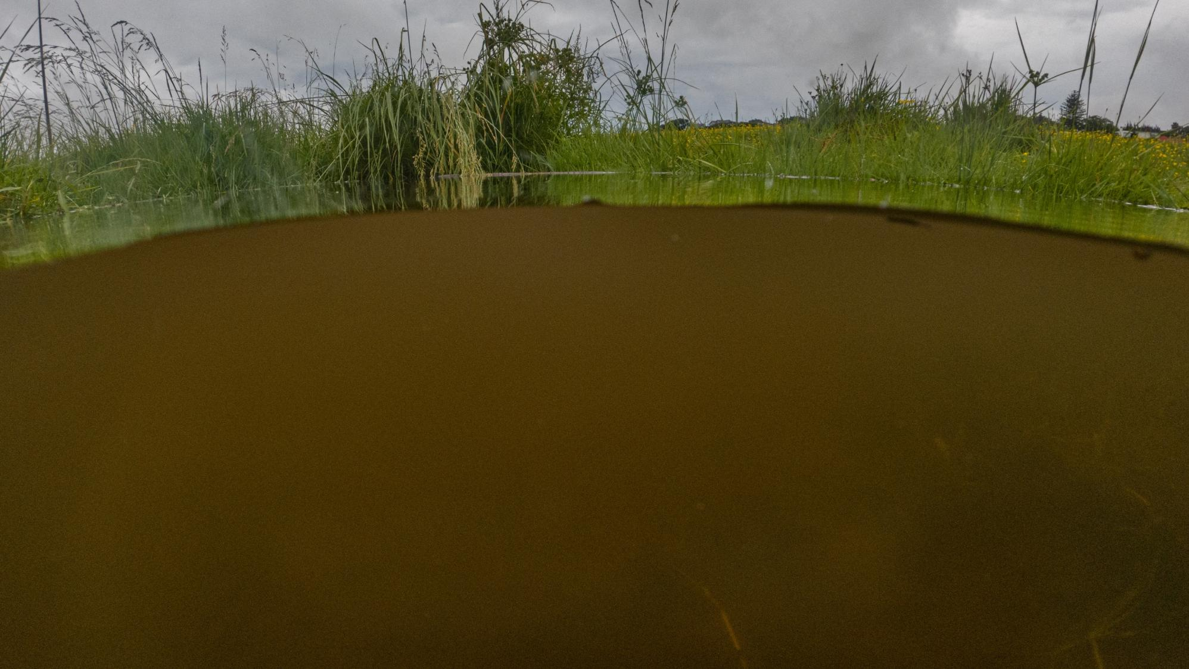
Photo by Shaun Lee

Slide 2

Photo by Shaun Lee

Slide 3

Photo by Shaun Lee

Slide 4
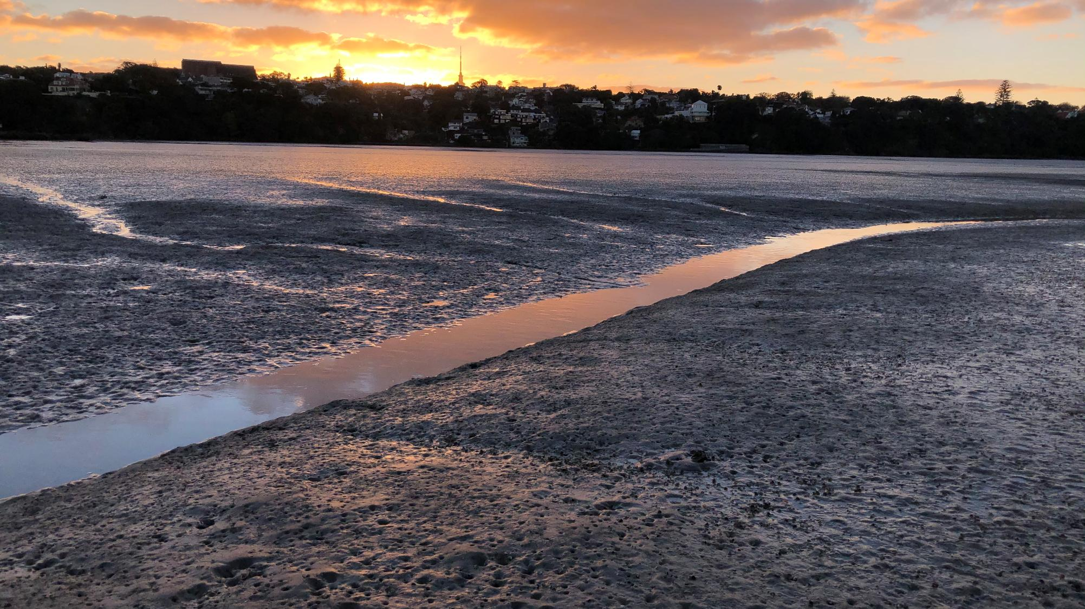
Photo by Shaun Lee

Slide 5

Photo by Shaun Lee

Slide 6
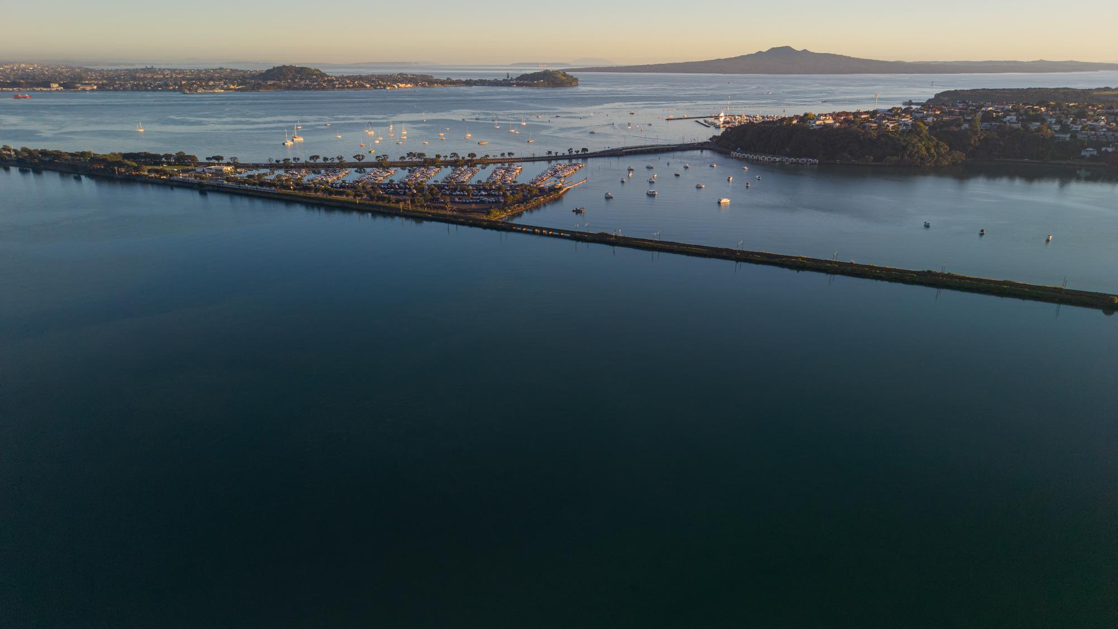
Photo by Shaun Lee

Slide 7
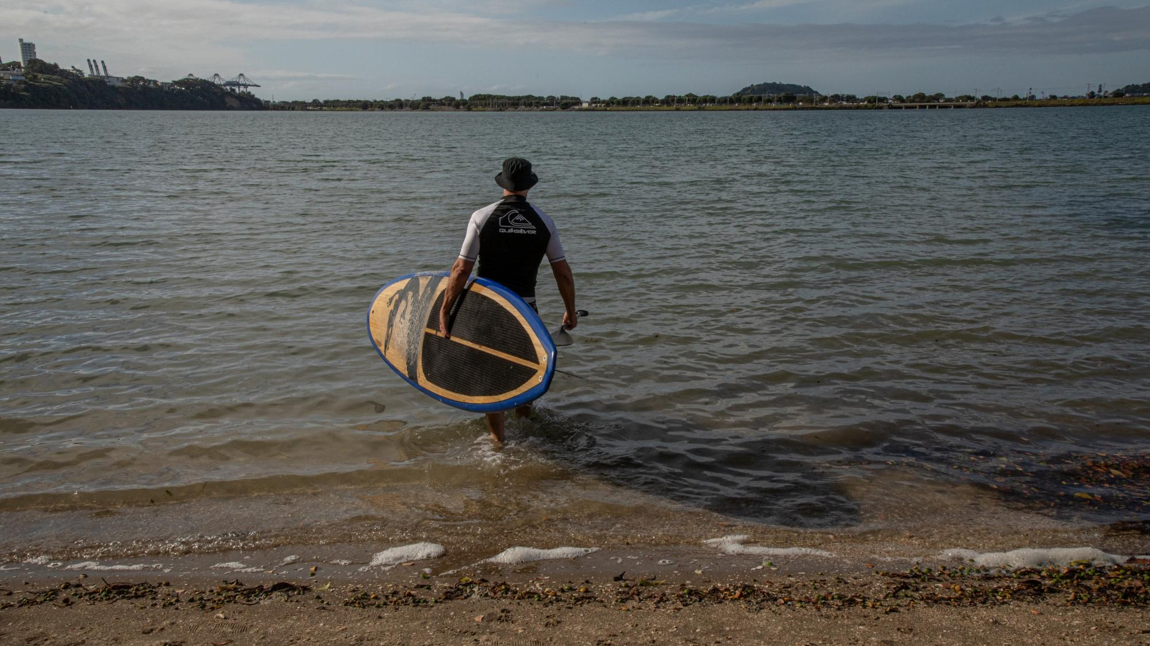
Photo by Shaun Lee

Slide 8
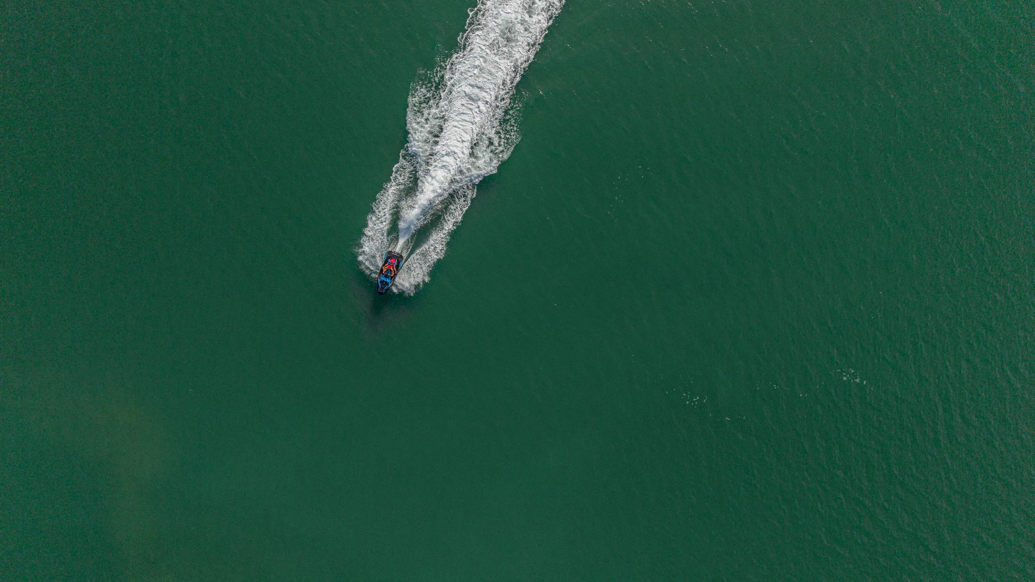
Photo by Shaun Lee

Slide 9
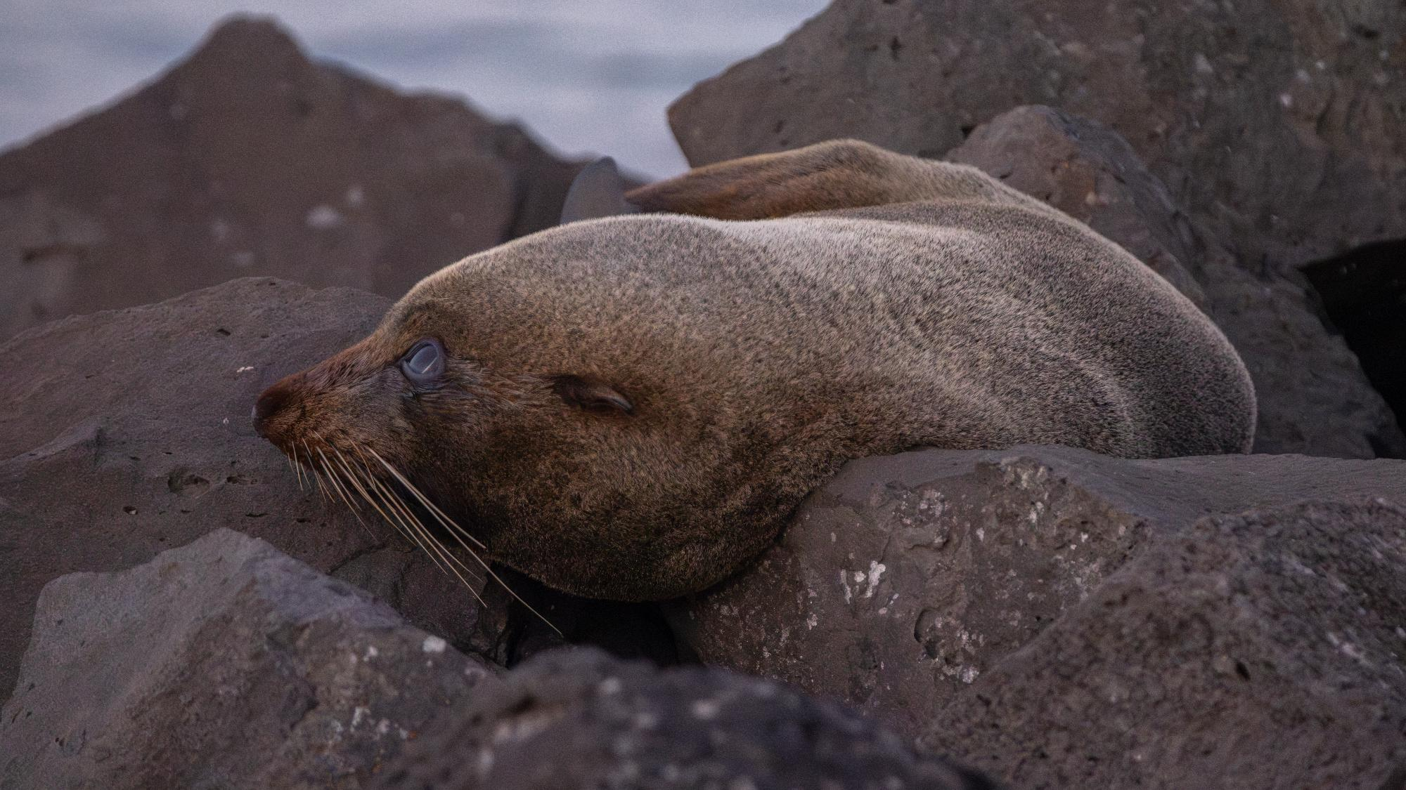
Photo by Shaun Lee

Slide 10

Photo by Shaun Lee

Slide 11

Photo by Shaun Lee

Slide 12
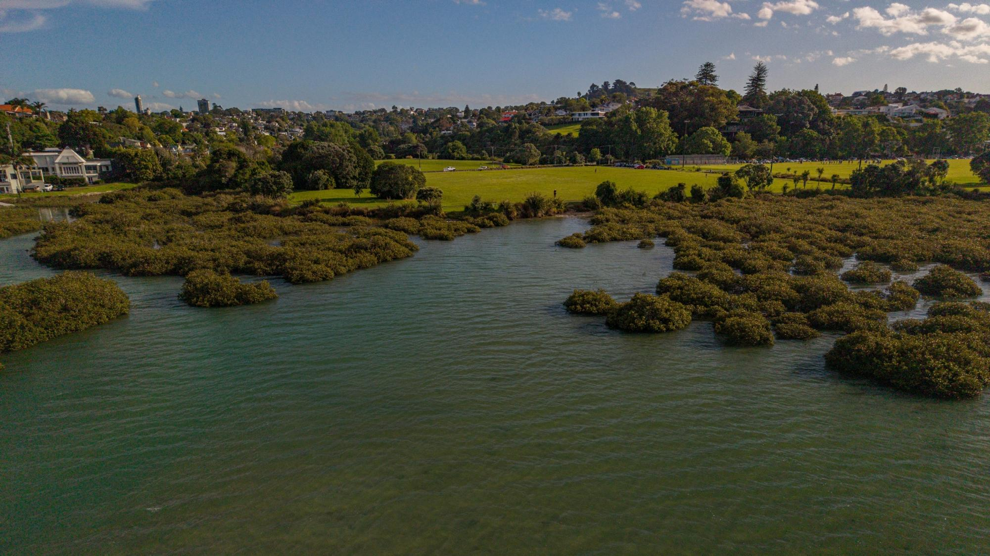
Photo by Shaun Lee

Slide 13
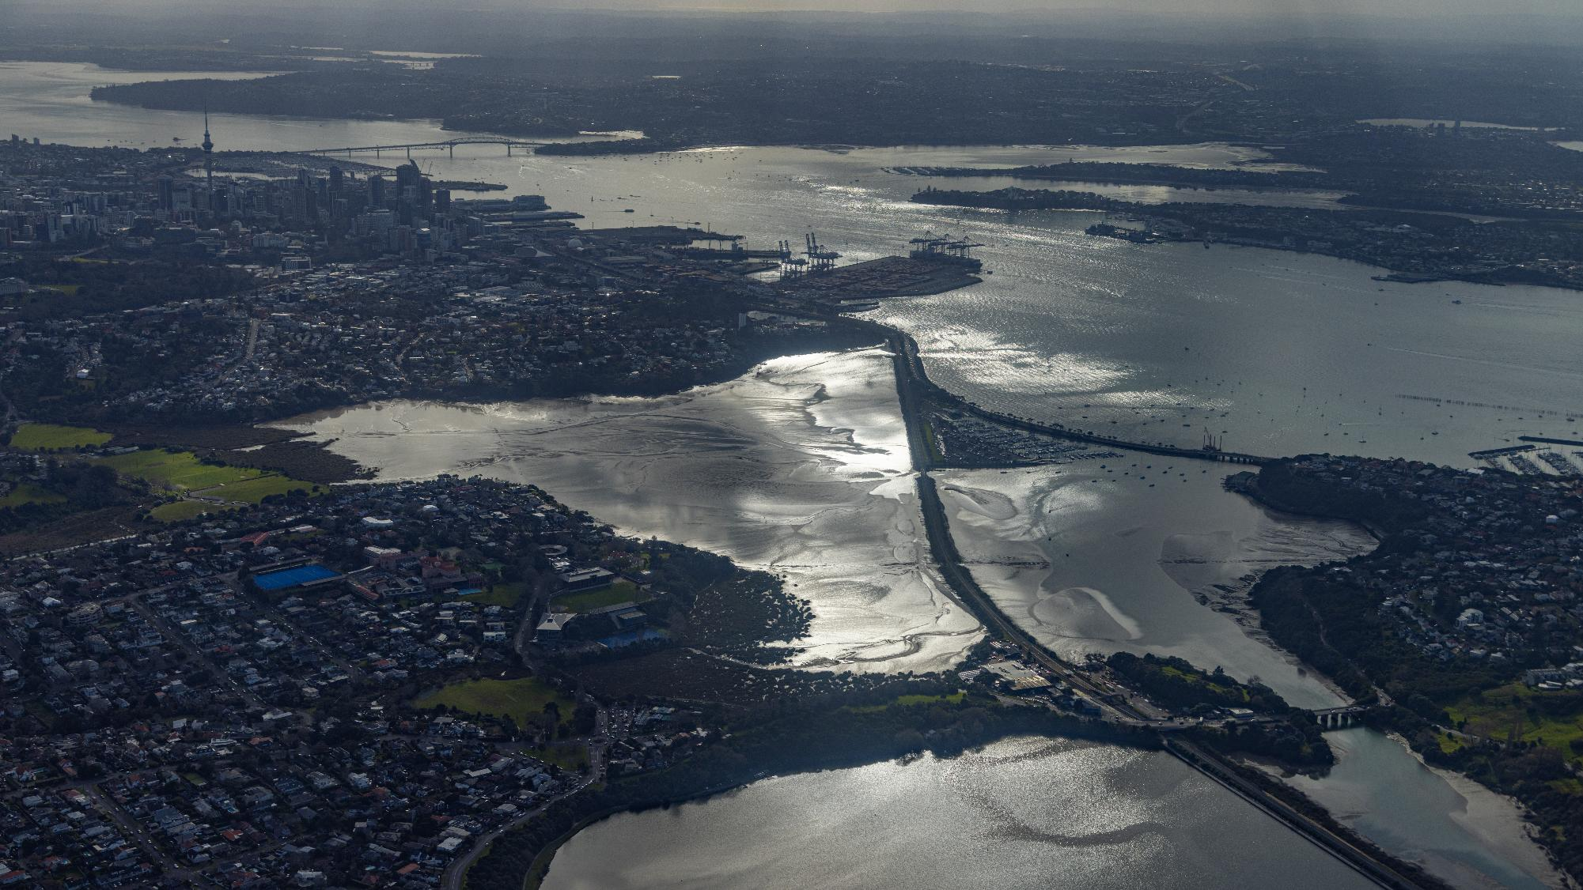
Photo by Shaun Lee

Slide 14

Photo by Shaun Lee

Slide 15

Photo by Shaun Lee

